Slide 1
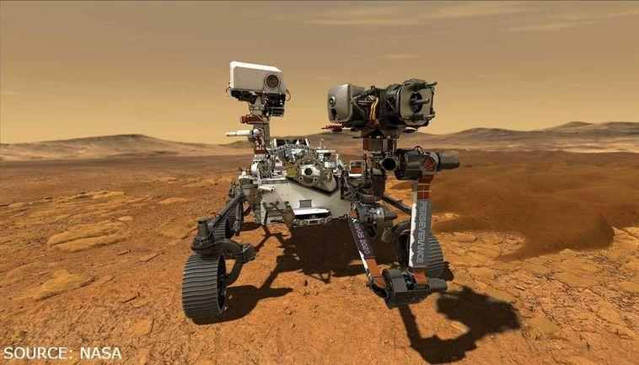
MARS ROVER
By 1523889

Slide 2
INTRODUCTION History of (NASA)
1997 First Nasa Mars rover SoJourner land on mars to take picture and atmosphere(together with PathFinder )
2004 Spirit & Opportunity rover land (size of golf cart) send to understand mars land
2012 Curiosity Launched (size of mini cooper)more advanced search for life
2020 perseverance same as curiosity but many other advance sensors and also driller together with ingenuity helicopter

Slide 3
PHYSICAL DESIGN

Slide 4
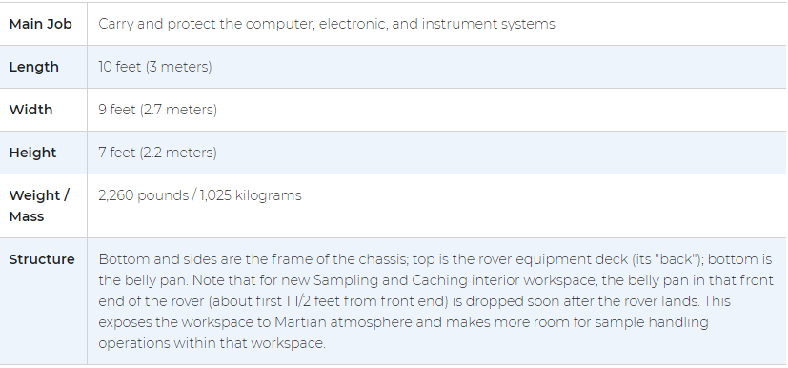
Tech Specs
The Perseverance rover's body is called the warm electronics box, or "WEB" for short. Like a car body, the rover body is a strong, outer layer that protects the rover's computer and electronics (which are basically the equivalent of the rover's brains and heart). The rover body thus keeps the rover's vital organs protected and temperature-controlled.

Slide 5
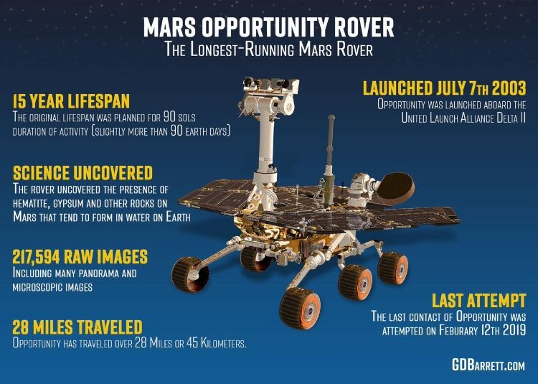
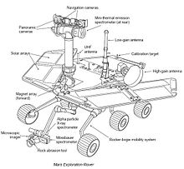
Opportunity & Spirit

Slide 6
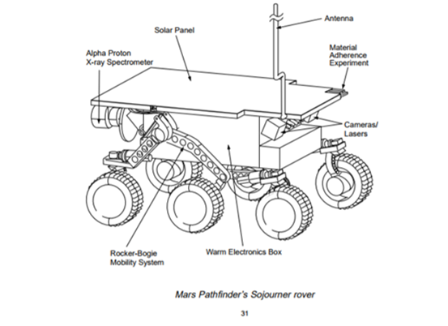
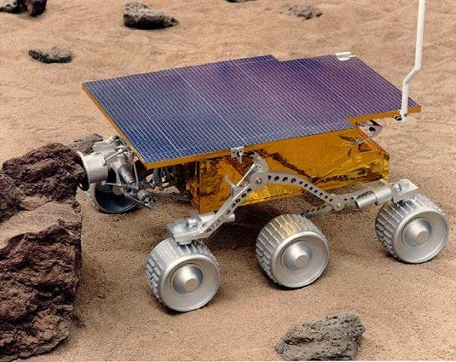
SoJourner

Slide 7
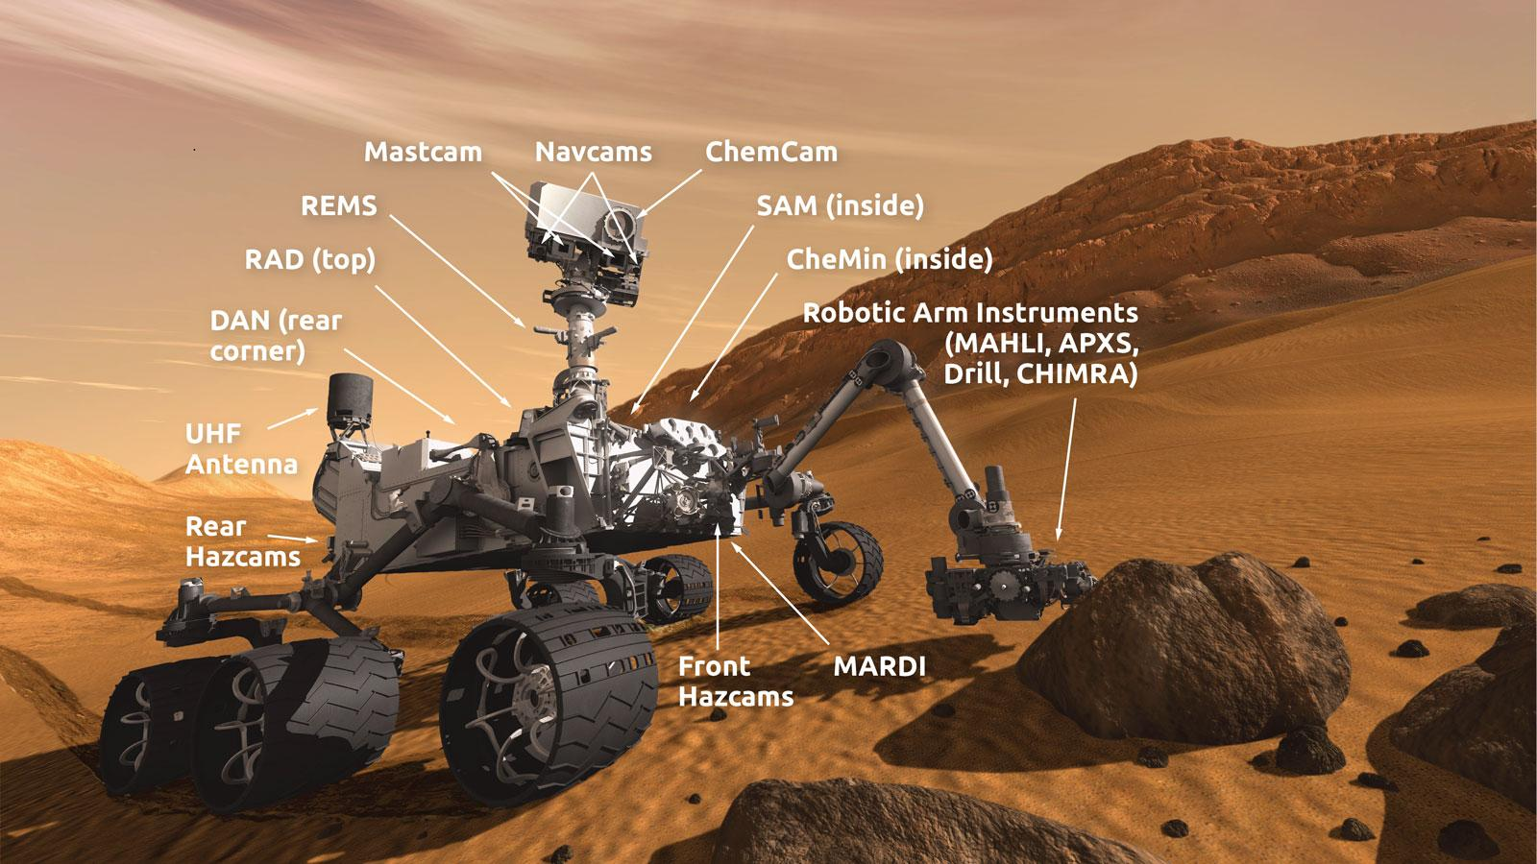
curiosity

Slide 8
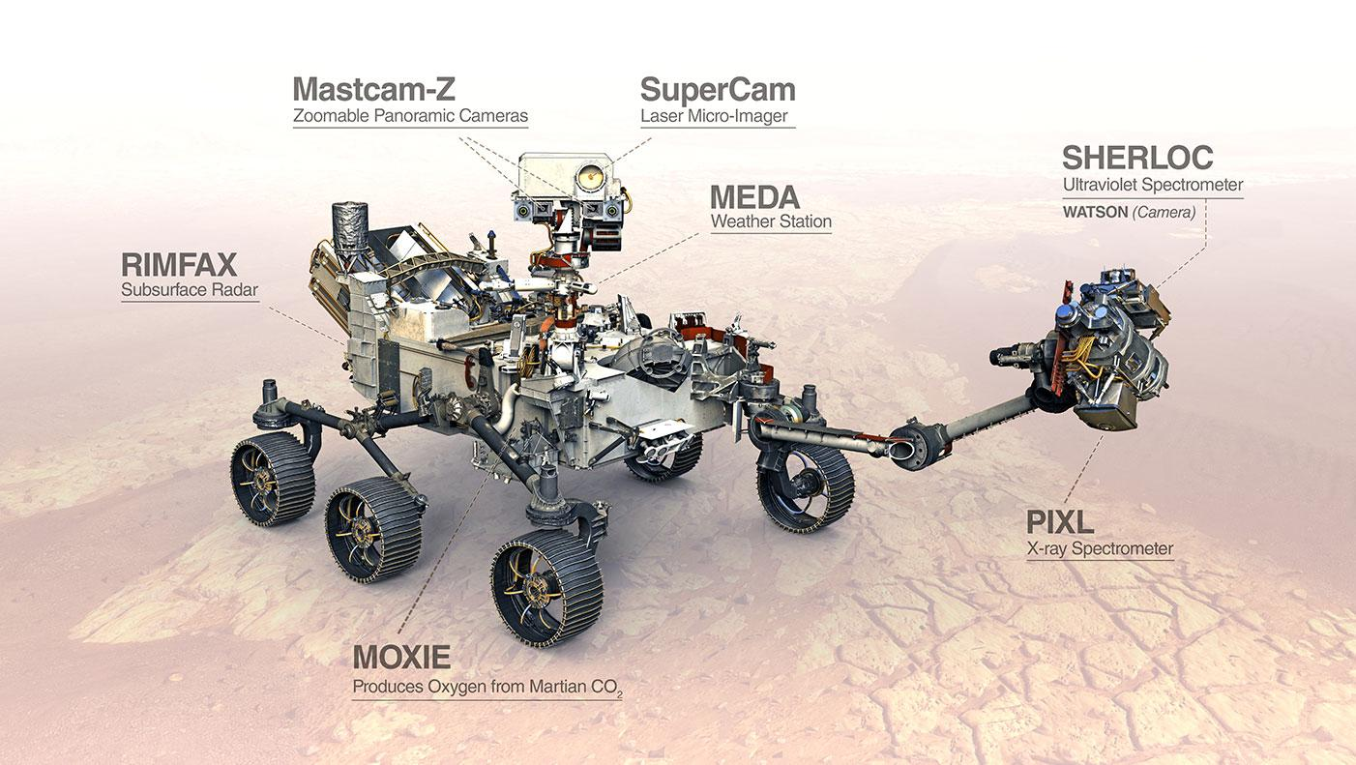
Perseverance

Slide 9
Locomotion system &
actuators

Slide 10
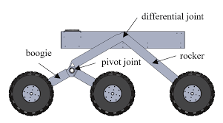
Differential Rocker Boogie Mechanism
The rockers are attached either side of the rover with the body through a differential. One end of the rocker is attached to a wheel and the other is pivoted to the bogie.
​
Based on the center of mass, the Perseverance rover can withstand a tilt of at least 45 degrees in any direction without overturning.
​
The differential link allows the rover go through different obstacles on either side at the same time in a stable way.​

Slide 11
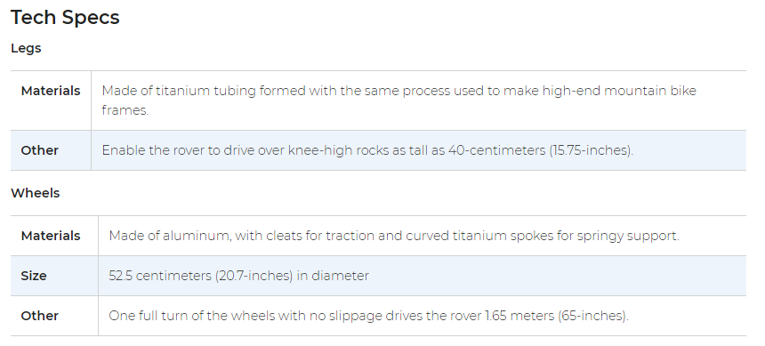
The Mars Rover Wheels and Legs

Slide 12
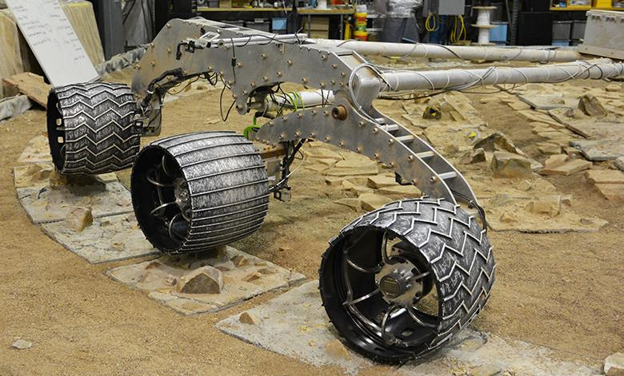

Slide 13
Navigation system (sensors &
control

Slide 14
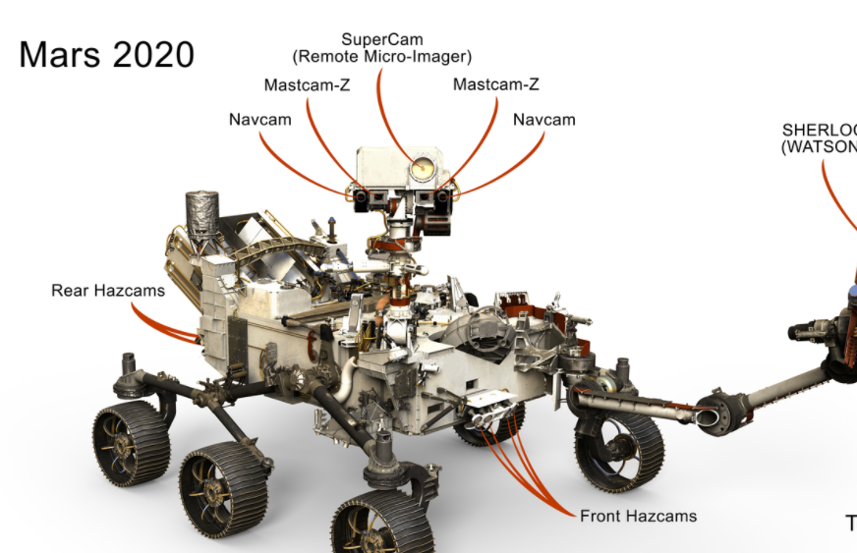

Slide 15
Camera
The Mars rover has total of 23 cameras (engineering cameras 9,science cameras 7 and landing cameras 7 )
Takes color images and color video footage of the Martian terrain.
Mounted about human-eye height.
Similar to that of consumer digital cameras; 2 megapixels.
1600 X 1200 pixels.
8 Gigabyte memory allows several hours of HD video

Slide 16
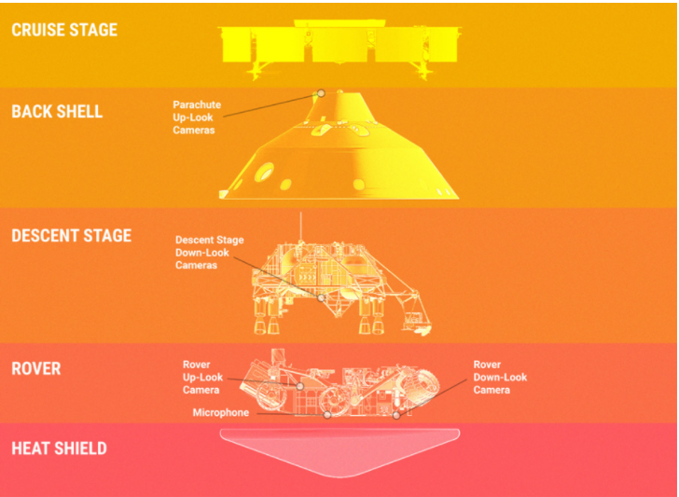
Entry, Descent, and Landing Cameras

Slide 17
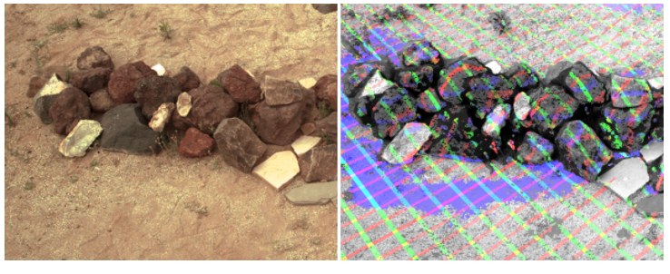
Engineering Cameras for Driving

Slide 18
Data Transmission

Slide 19
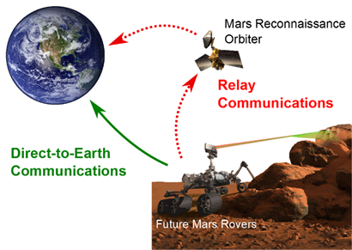
Data Transmission
The Rover has three antennas which are Ultra-High Frequency, High-Gain, and Low-Gain Antenna. They are the “voice” and “ears” of the Rover.
UHF communicates with the Earth through NASA’s Mars orbiters using high-frequency waves around 400MHz. The orbiters then use their much larger antennas and transmitters to relay that data on the long-distance link back to Earth.
The differential link allows the rover go through different obstacles on either side at the same time in a stable way.
Activities like taking photographs, driving, and driving the instruments are all controlled by commands sent to the rover from the flight team on Earth in a command sequence

Slide 20
Data Collection

Slide 21
Rover Antennas
The rover has both a low-gain and high-gain antenna that serve as both its "voice" and its "ears". They are located on the rover equipment deck.
The low-gain antenna sends and receives information in every direction; that is, it is "omni-directional." The antenna transmits radio waves at a low rate to the Deep Space Network (DSN) antennas on Earth.
The high-gain antenna can send a "beam" of information in a specific direction and it is steerable, so the antenna can move to point itself directly to any antenna on Earth.

Slide 22
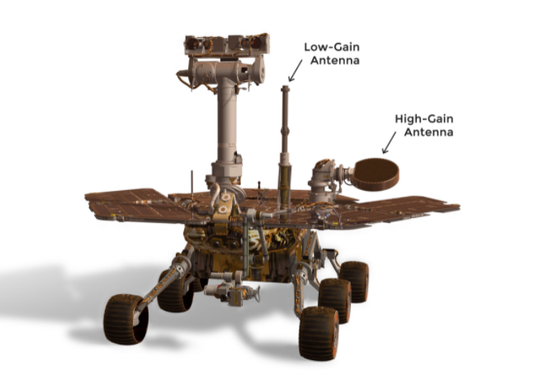
The low and high-gain antenna

Slide 23
Microphones on the Perseverance Rover
Recording the Sounds on Mars
Engineers have equipped Perseverance to be a good listener. It has Entry Descent and Landing (EDL) microphones that will record the sounds of landing. SuperCam's toolkit also consists of a microphone that will help study Mars rocks and soil. We may even be able to hear the sounds of the rover itself.
Microphone on SuperCam
SuperCam identifies minerals and rock compositions, and it seeks organic compounds that could be related to past life on Mars. It has a laser that can zap and study areas on a rock as small as the period at the end of this sentence. All from about 20 feet, or 7 meters away. Its camera and spectrometers then examine the rock's chemistry.

Slide 24
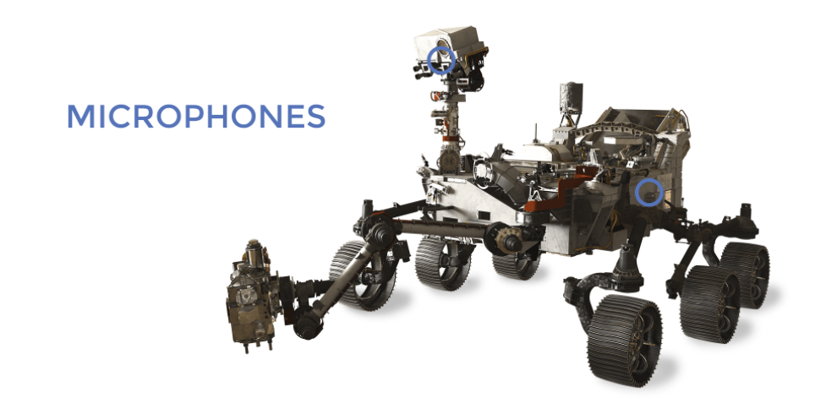

Slide 25
Power management

Slide 26
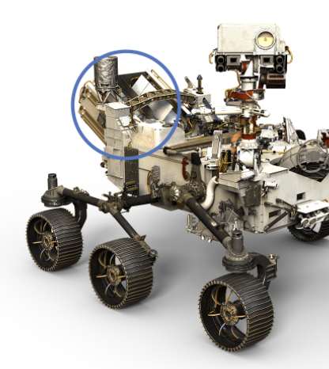

Slide 27
Power source -Electrical Power
The Perseverance rover requires electrical power to operate.
Without power, the rover cannot move, use its science instruments, or communicate with Earth.
Perseverance carries a radioisotope power system. This power system produces a dependable flow of electricity using the heat of plutonium's radioactive decay as its "fuel."
The power source is called a "Multi-Mission Radioisotope Thermoelectric Generator" or MMRTG for short. The MMRTG converts heat from the natural radioactive decay of plutonium into electricity. This power system charges the rover's two primary batteries. The heat from the MMRTG is also used to keep the rover's tools and systems at their correct operating temperatures.

Slide 28
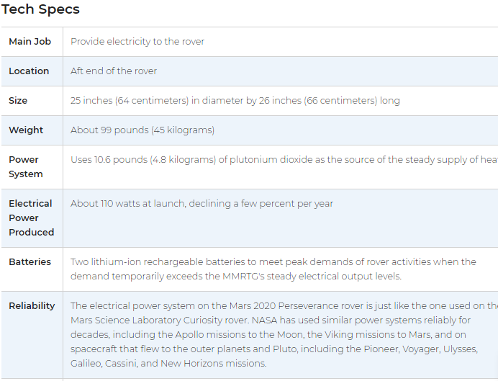

Slide 29
Thank you

